Slide 1


The Evolving Battle for Digital Privacy
How Technology Shapes, Threatens & Redefines Personal Privacy
By: Llyjah Thompson
Notes:
Hi everyone, my name is Llyjah Thompson, and today I’ll be presenting The Evolving Battle for Digital Privacy. This project explores how technology shapes, threatens, and redefines personal privacy — and what we can do to protect it.

Slide 2
What Is Privacy?
A Modern Computing Definition
Control over personal data
Ability to choose what is collected
Ability to choose how it's used
Ability to choose who can access it
The fundamental right to govern your own information and determine how it exists in digital systems
The power to decide which personal information organizations can gather about you
The right to determine the purposes for which your data can be processed and applied
The authority to control which parties and entities have permission to view or use your information
Notes:
Privacy means control over our personal information — deciding what’s collected, how it’s used, and who can access it. In computing, privacy isn’t just a right; it’s a technical framework that defines how data exists and moves through digital systems.

Slide 3

Why Privacy Matters?
The Stakes Are Higher Than Ever
Massive Data Collection
AI Models Trained on Personal Info
Cloud Storage Vulnerabilities
Companies gather vast amounts of personal information from every online interaction, creating detailed profiles of our behaviors and preferences.
Machine learning systems are increasingly built using collected personal data, raising concerns about consent and the purposes of these models.
As data migrates to cloud platforms, new security risks emerge, with potential exposure through misconfigurations and unauthorized access.
Data Breaches Affecting Millions
Surveillance Becoming Normalized
High-profile breaches expose sensitive information of millions of users, compromising identities and financial security at scale.
Constant monitoring through devices and platforms has become routine, gradually eroding the expectation of privacy in daily life.
Notes:
Why Privacy Matters
Every click, search, and message generates data. Companies collect massive amounts of it, AI models train on it, and breaches expose millions. As surveillance becomes normalized, privacy is no longer optional — it’s essential for digital freedom.

Slide 4
Core Computing Issues
Where Privacy Breaks Down
Weak Encryption
Excessive Data Collection
Dark-Pattern Consent
Third-Party Tracking
Inadequate encryption protocols and poor key management expose sensitive data to unauthorized access and interception during transmission and storage.
Embedded trackers from advertising networks and analytics vendors monitor user behavior across websites, creating comprehensive profiles without explicit user awareness or permission.
Organizations gather far more personal information than necessary, creating large targets for breaches and increasing the scope of potential privacy violations.
Deceptive user interface designs and misleading consent mechanisms obscure true data usage practices, preventing users from making informed decisions about their information.
Insecure APIs & Cloud Configs
Misconfigured cloud storage, unprotected API endpoints, and inadequate access controls create exploitable vulnerabilities that expose confidential user data to attackers.
Notes:
Privacy breaks down when systems fail. Weak encryption, excessive data collection, deceptive consent forms, and insecure APIs all create vulnerabilities. These aren’t abstract problems — they’re design flaws that directly affect user safety.

Slide 5

Meta Pixel Healthcare Leak (2022)
What Happened
Computing Issues
Why It Matters
A single embedded script caused a national privacy breach, exposing millions of patients and raising critical questions about healthcare data security.
Meta's tracking pixel found on hospital websites sent patient data to Facebook, including appointment details, IP addresses, and medical conditions.
Misconfigured tracking scripts operated without user consent, violating HIPAA regulations and fundamental data protection principles.
Notes:
Case Study #1: Meta Pixel Healthcare Leak
In 2022, Meta’s tracking pixel was found on hospital websites, sending patient data to Facebook. A single script violated HIPAA principles and exposed millions of patients. This case shows how small pieces of code can cause massive privacy breaches.

Slide 6
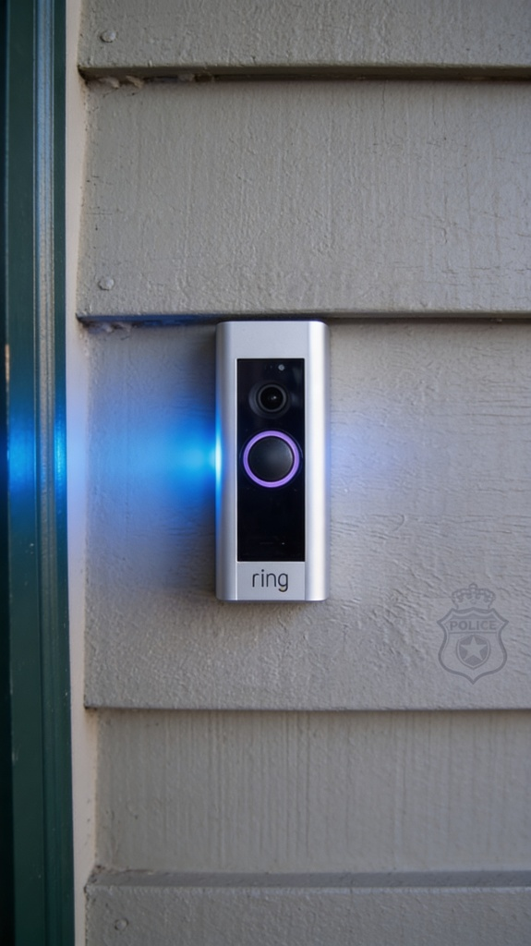
Ring Doorbell Police Partnerships
What Happened
Computing Issues
Why It Matters
Consumer technology designed for home security was transformed into surveillance infrastructure, blurring the line between personal privacy and public monitoring systems.
Ring partnered with 2,000+ police departments, allowing police to request footage directly from users. Critically, users were often unaware of how their data was being used and accessed.
Surveillance creep enabled by widespread camera networks, cloud storage risks from centralized data, and weak access controls allowing unauthorized data access by law enforcement.
Notes:
Case Study #2: Ring Doorbell Police Partnerships
Ring partnered with over 2,000 police departments, allowing direct access to user footage. Many users didn’t realize their data was being shared. What began as home security turned into a nationwide surveillance network — a clear privacy concern.

Slide 7





Real-World Computing Problems
Privacy Fails Because Systems Fail
Unencrypted Data Transfers
APIs Exposing Sensitive Info
Indefinite Data Retention
Data transmitted without encryption protocols, exposing sensitive information to interception during transit across networks and systems.
Application programming interfaces inadvertently leaking personal and confidential data through poorly secured endpoints and inadequate access controls.
Organizations storing user data indefinitely without clear deletion policies, increasing exposure window and regulatory compliance risks over time.
Third-Party Trackers Everywhere
AI Trained on Private Data
Invisible tracking mechanisms embedded across websites and applications, collecting behavioral and personal data without explicit user consent.
Machine learning models trained using sensitive user information without proper anonymization, risking privacy breaches and data misuse.
Notes:
Real‑World Computing Problems
Privacy failures happen because systems are built without protection in mind. Unencrypted transfers, exposed APIs, indefinite data storage, and AI trained on private data all expand risk. These technical oversights have human consequences.

Slide 8

Ethical Concerns
Privacy Is Also a Moral Issue
Users Don't Understand Agreements
Companies Profit from Over-Collection
AI Infers Sensitive Traits
Artificial intelligence systems can infer intimate personal attributes like political beliefs, sexual orientation, and health conditions from incomplete or seemingly innocuous data.
Most users never read terms and conditions, blindly accepting data collection policies without understanding the implications and scope of data sharing.
Organizations collect far more personal data than necessary, monetizing user information through advertising, analytics, and third-party sales for maximum revenue.
Surveillance Impacts Marginalized Groups Most
Surveillance systems disproportionately affect minorities and vulnerable populations, reinforcing discrimination and limiting freedom for already disadvantaged communities.
Notes:
Privacy is also an ethical issue. Most users don’t understand what they agree to, while companies profit from over‑collection. AI can infer sensitive traits, and surveillance disproportionately affects marginalized communities. Ethics must guide technology design.

Slide 9





Technical Solutions
Fixing Privacy at the System Level
End-to-end encryption
Zero-trust architecture
Differential privacy
Secure API design
Build APIs with strict authentication, rate limiting, input validation, and encryption to prevent unauthorized access and data breaches.
Secure data transmission from sender to recipient with military-grade encryption protocols, ensuring no intermediary can access sensitive information.
Implement continuous verification at every access point, eliminating implicit trust and requiring authentication for all users and devices.
Add statistical noise to datasets to protect individual privacy while maintaining data utility for analysis and research purposes.
Data minimization
Pen-testing & audits
Collect and store only essential data required for specific purposes, reducing exposure surface and privacy risks through principle of least privilege.
Conduct regular security assessments and penetration tests to identify vulnerabilities, validate controls, and ensure compliance with privacy standards.
Notes:
We can fix privacy at the system level. End‑to‑end encryption, zero‑trust architecture, differential privacy, secure API design, and data minimization all reduce exposure. Regular audits ensure these protections actually work.

Slide 10
Policy Solutions
Fixing Privacy at the Governance Level
GDPR & CCPA Enforcement
Transparency Reports
Data Retention Limits
Independent Audits
Strict regulatory compliance with global data protection standards, ensuring organizations meet all legal requirements and avoid substantial fines
Comprehensive documentation of data handling practices, enabling organizations and users to understand how personal information is collected and processed
Enforced time-based deletion policies that prevent indefinite data storage, reducing privacy risks and unnecessary data accumulation
Regular third-party verification of privacy practices and compliance measures, providing objective assessment and accountability to stakeholders
Clear Consent Requirements
Explicit user authorization mechanisms ensuring individuals maintain control over their personal data and understand data usage purposes
Notes:
Laws matter too. Regulations like GDPR and CCPA enforce transparency, limit data retention, and require consent. Independent audits and clear reporting keep organizations accountable. Policy complements technology — both are needed.

Slide 11
Your Analysis
Privacy Fails by Design, Not Accident
Companies Choose to Collect Too Much
Users Can't Protect Themselves
Privacy Must Be Built In, Not Added Later
Privacy by Design Is the Only Sustainable Model
Organizations prioritize data accumulation over user needs, collecting information far beyond what is necessary for service delivery.
Despite awareness, individuals lack the technical and structural means to prevent unwanted data collection and tracking.
Retrofitting privacy measures into existing systems proves ineffective; privacy protection must be foundational from inception.
Integrating privacy principles throughout product development, governance, and operations ensures lasting protection and user trust.
Notes:
Privacy failures aren’t accidents — they’re design choices. Companies collect too much, users can’t defend themselves, and retrofitted fixes don’t last. Privacy must be built in from the start — “privacy by design” is the only sustainable model.

Slide 12

Future of Privacy
What's Coming Next
1
AI will require stricter data controls
2
Biometrics will become a major battleground
3
Governments will expand digital surveillance
Artificial intelligence systems demand access to vast amounts of personal data, necessitating robust regulatory frameworks and enhanced privacy protections to prevent misuse and unauthorized access.
State-level monitoring capabilities will grow substantially, raising concerns about citizen privacy rights and the balance between national security and individual freedoms.
Facial recognition, fingerprint scanning, and other biometric technologies will spark significant privacy debates as they become ubiquitous in security and identification systems worldwide.
4
Privacy-preserving tech will become standard
Encryption, differential privacy, and other privacy-enhancing technologies will be integrated into mainstream platforms and applications as consumers demand greater control over their personal information.
Notes:
Looking ahead, AI will demand stricter controls, biometrics will spark new debates, and governments will expand surveillance. But privacy‑preserving technologies will also become standard as users demand more control. The future depends on how we balance innovation with protection.

Slide 13
Conclusion
Privacy = Technical + Ethical + Policy
Real-world Cases
Computing Decisions
Human Rights
Real-world cases show how fragile privacy is in the face of technological change and systemic vulnerabilities.
Computing decisions shape user safety and privacy outcomes, requiring careful consideration of both technical design and human impact.
Protecting privacy protects human rights, enabling individuals to maintain autonomy and dignity in an increasingly digital world.
Notes:
Privacy is technical, ethical, and political. Real‑world cases show how fragile it is, and computing decisions shape user safety. Protecting privacy means protecting human rights — it’s about autonomy and dignity in a digital world.

Slide 14
References
The Markup — Meta Pixel Investigation
Wired — Ring Surveillance Reports
EFF Privacy Research
GDPR Official Documentation
Electronic Frontier Foundation research on digital privacy rights and consumer protections.
General Data Protection Regulation framework governing data privacy in the European Union.
Investigative reporting on Meta Pixel tracking and privacy concerns across websites.
In-depth analysis of Ring doorbell surveillance practices and privacy implications.
CCPA Privacy Act
NIST Privacy Framework
California Consumer Privacy Act establishing privacy rights and data protection standards.
National Institute of Standards and Technology guidelines for privacy risk management and protection.

Slide 15
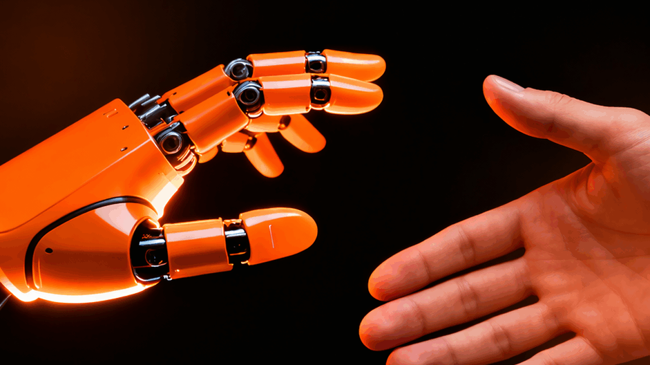
Thank You
Questions?
Notes:
Thank you for listening.

